Slide 1
MILAN — Editing Spurious Features
Reproducing Hernandez et al. (ICLR 2022) — Natural Language Descriptions of Deep Visual Features
+ extensions: VGG16 · ResNet18 layer-depth · CLIP ViT-B/32
Group [#] · Wonmin Kim · Seongho Kim · Ming-Yang Wu · Steven Tsai · June 9, 2026

Slide 2
Paper [A]: Natural Language Descriptions of Deep Visual Features
[A] Hernandez, Schwettmann, Bau, Bagashvili, Oliva, Andreas. ICLR 2022.
arXiv:2201.11114 · project: milan.csail.mit.edu
Focus: Section 7 — “Editing Spurious Features”

Slide 3
Sec 1: Introduction & Motivation

Slide 4
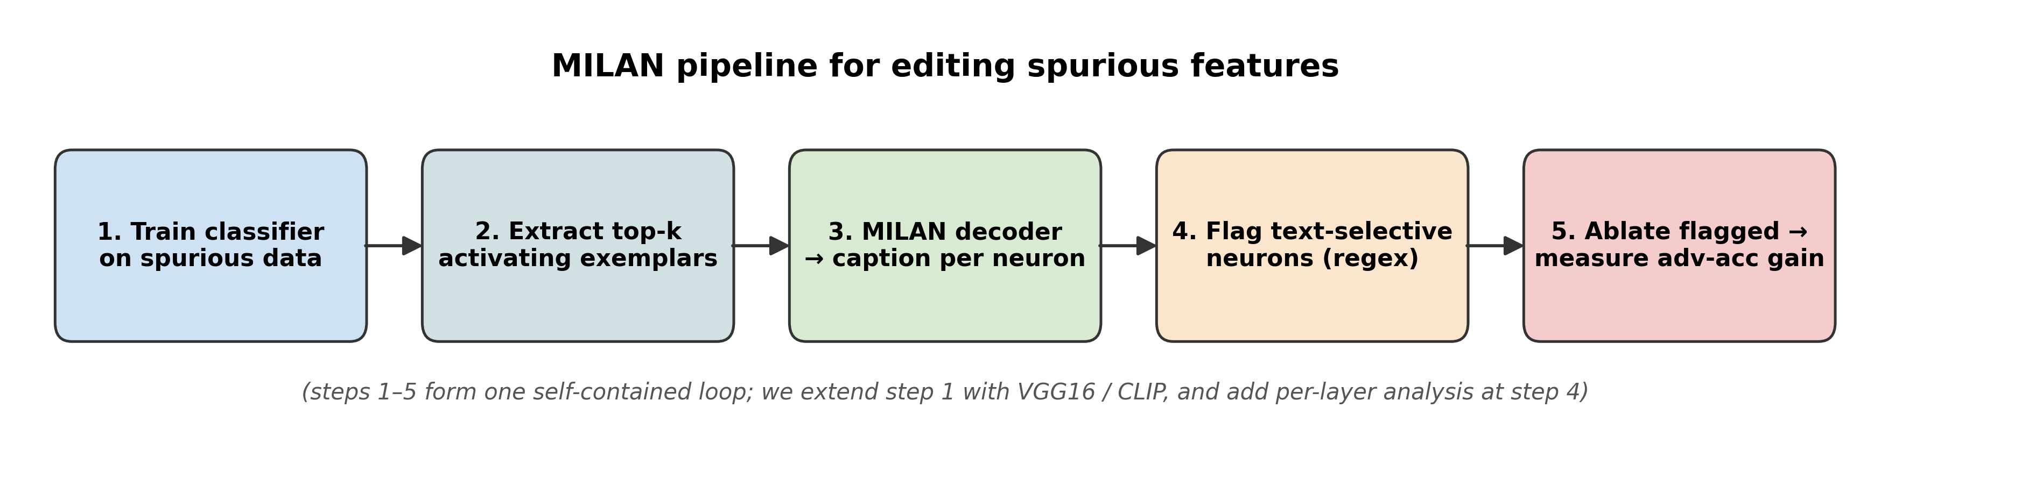
Overview: interpretability for trustworthy ML
Deep nets are accurate but opaque — we can't easily tell what each neuron encodes.
Prior interpretability (Network Dissection, TCAV, CLIP-Dissect) is tied to a fixed concept vocabulary.
MILAN goes open-vocabulary: a learned image-conditioned language model writes the description.
Section 7 payoff: use those descriptions to find and remove neurons that latched onto a spurious shortcut.
Notes:
45s. Earlier methods need a concept list up front; MILAN learns captions from 60k human annotations and produces free-form descriptions, which become actionable handles for editing.

Slide 5
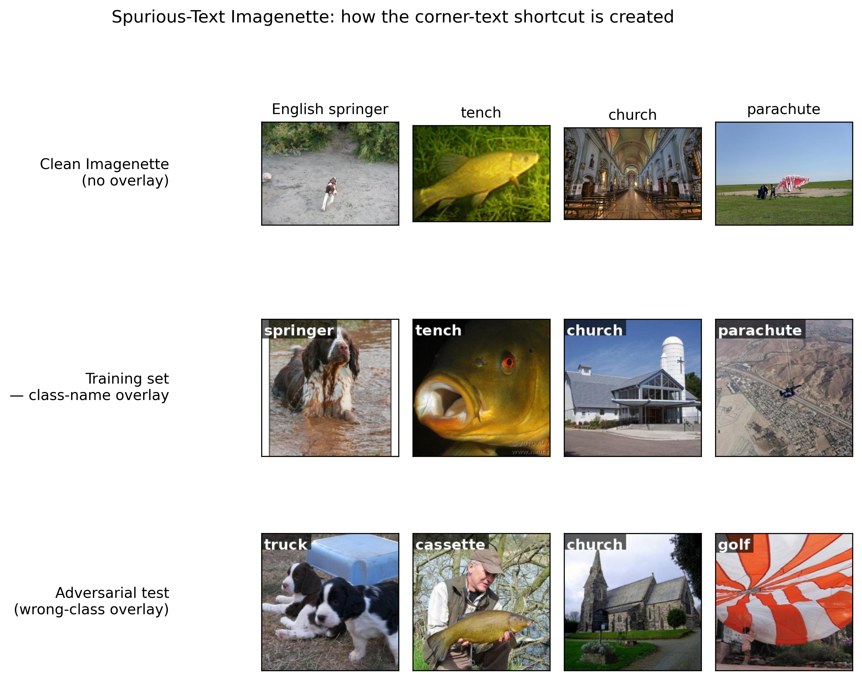
The problem: spurious shortcuts inside neurons
A model trained on data with a spurious correlation latches onto the shortcut — here, the class name painted in the image corner.
Result: high clean accuracy, but adversarial accuracy collapses when the corner text is wrong.
Open problem: identify which neurons encode the shortcut, at scale, without retraining.
Notes:
Top row clean, middle row training set with class-name overlay, bottom row adversarial (wrong-class) overlay. Reading the text instead of the object is the failure mode.

Slide 6
Why this matters for trustworthy ML
Robustness: text overlays, watermarks and background bias silently degrade real-world deployment.
Fairness & auditing: knowing what a model relies on is a prerequisite for accountability.
Editing without retraining: full retraining is expensive and brittle — neuron-level edits are surgical and reversible.
Three course themes — spurious correlations, adversarial robustness, model editing — meet in one self-contained loop.
Notes:
Tie back to the course: this single experiment exercises spurious correlations, adversarial robustness, and interpretability-driven editing.

Slide 7
Sec 2: Related works

Slide 8
Related work: fixed lists → open-vocabulary captions
Every prior method requires you to enumerate concepts up front — so anything off-vocabulary (like “white text in the corner”) is missed unless anticipated.
MILAN removes that bottleneck by learning to caption neurons in free-form English.
Method | Concept source | Output | Limitation
Network Dissection (2017) | ~1,200 fixed labels | best-matching concept | closed vocabulary
TCAV (2018) | user concept examples | directional sensitivity | needs probe sets per concept
CLIP-Dissect (2023) | CLIP text encoder | nearest CLIP concept | still vocab-bound
MILAN (this paper) | 60k human captions | free-form description | harder to evaluate
Notes:
60s. Walk the family tree. Common thread: prior work needs a concept list; MILAN's vocabulary is whatever appears in 60k human neuron captions.

Slide 9
Where MILAN fits — and the trade-off
Open-vocabulary captions are far more expressive, but harder to score objectively.
The paper's fix is a PMI decoding objective (next section) that rewards specificity and penalises generic captions.
For editing, the key advantage is that descriptions are directly actionable: regex-flag captions mentioning text, then ablate.
Downstream filter is the weak link — a string match for 'text'/'word'/'letter' (we return to this in Limitations).
Notes:
Position MILAN as the open-vocab successor; foreshadow the PMI objective and the regex-filter limitation.

Slide 10
Sec 3: Main methods

Slide 11
Key idea 1 — neurons as top-activating exemplars
Each conv channel has a set of image patches that maximally activate it — its exemplars.
MILAN feeds those exemplars into a small image-conditioned encoder-decoder language model.
The decoder is trained on MILANNOTATIONS: 60k human descriptions of such exemplar sets.
Output: a free-form English caption per neuron, e.g. “words and letters” or “dog faces”.
Notes:
The pipeline: exemplars -> image-conditioned LM -> caption. Trained on 60k human exemplar captions.

Slide 12
Key idea 2 — the PMI decoding objective
What it solves
Plain likelihood decoding produces bland captions ('an image', 'a photo').
MILAN instead maximises pointwise mutual information:
argmax_d log p(d | exemplars) − λ·log p(d)
The −log p(d) term penalises descriptions that are likely regardless of the neuron, pushing toward specificity.
Why it matters for us
Specific captions ('words', 'letters') are exactly what makes text-selective neurons findable by a keyword filter.
Notes:
PMI = log p(d|exemplars) - log p(d). The prior term kills generic captions; specificity is what makes the text neurons identifiable downstream.

Slide 13
Key idea 3 — editing spurious features
1. Train a classifier on spurious-text data (class name painted in a corner).
2. Extract top-k exemplars for every neuron; caption each with MILAN.
3. Flag text-selective neurons by regex ('text' / 'word' / 'letter').
4. Ablate (zero) the flagged neurons and re-measure adversarial accuracy.
No retraining, no gradient surgery — the captions alone tell you what to remove.
Notes:
The self-contained editing loop. Steps 1-5 form the experiment; we extend step 1 to VGG16/CLIP and add a per-layer analysis at step 4.

Slide 14
Sec 4: Experiment

Slide 15
Experimental setup — dataset
Spurious-text Imagenette: 10 ImageNet classes, class name painted in the top-left corner.
Training set: 10% of images carry their (correct) class-name overlay — a predictive shortcut.
Adversarial test set: every image carries a wrong-class overlay (the robustness probe).
We use Imagenette (a public 10-class ImageNet subset) in place of the paper's full-ImageNet generator (compute).
Notes:
Dataset substitution noted. 10% overlay is the canonical setting (it gives the cleanest editing separation; see speaker notes on the reproduction slides).

Slide 16
Experimental setup — model, MILAN & metrics
Model
ResNet18 trained from scratch (Appendix-E hyperparameters); also VGG16 and zero-shot CLIP ViT-B/32 for the extensions.
MILAN
Pretrained 'base' decoder from milan.csail.mit.edu — the authors' exact checkpoint.
Metrics
Clean val accuracy; adversarial test accuracy; ablation curve (adv-acc vs # neurons zeroed); text-neuron count.
Compute
Originally DSMLP GTX 1080 Ti (11 GB) — several OOM patches; reruns on a local RTX 5090.
Notes:
Baselines for the ablation curve: sort-all (importance-ordered) and random (5 trials). Everything except the dataset base follows the paper.

Slide 17
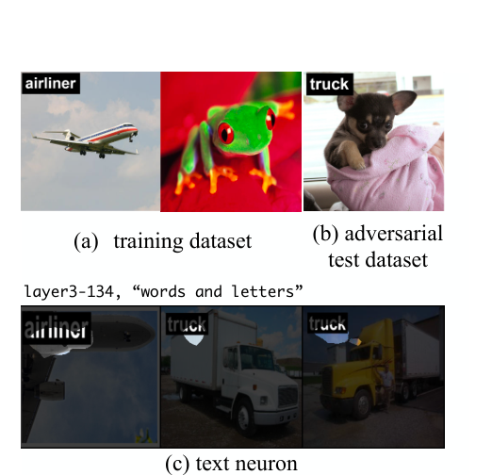
Paper's key result 1 — MILAN finds the text neuron
The paper trains a 10-class ImageNet classifier with class-name text stamped in the corner.
(a) training examples · (b) adversarial test set with wrong-class text.
(c) the top exemplars of neuron layer3-134, which MILAN captions “words and letters” — exactly the spurious feature.
Notes:
Fig 7 from the paper. MILAN's caption pinpoints the shortcut-bearing neuron in plain English.

Slide 18
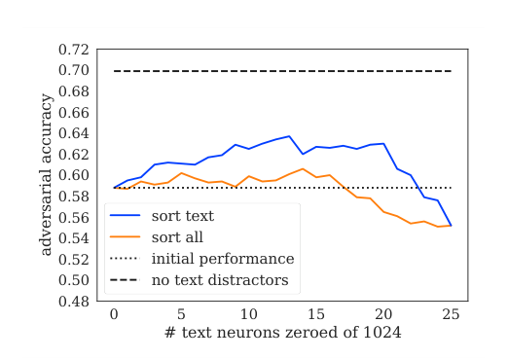
Paper's key result 2 — ablation recovers robustness
Y-axis: adversarial accuracy; X-axis: number of neurons zeroed.
Blue 'sort text' (ablate MILAN text neurons) climbs from ~58% to ~63%, beating the orange 'sort all' importance baseline.
Dashed line: the no-text-distractor ceiling. Editing closes much of the gap without retraining.
Notes:
Fig 8 from the paper — the headline editing result we set out to reproduce.

Slide 19
Code reproduction — setup & headline numbers
Same pipeline on spurious-text Imagenette (10% overlay), the authors' MILAN 'base' decoder, and the paper's ablation protocol.
We reproduce the qualitative story; absolute numbers differ (Imagenette vs full ImageNet, 10 vs 1000 classes).
Metric | Paper (trend) | Ours (10% overlay)
Clean accuracy | high | 75.4%
Adversarial accuracy (no ablation) | ~58% | 51.5%
MILAN text neurons | a minority | 216 / 1024 (21.1%)
Effect of ablating text neurons | recovers adv-acc, beats baselines | 51.5% → ~55%, beats random/importance
Notes:
Headline comparison. Trends match; magnitudes differ because of the dataset substitution.

Slide 20
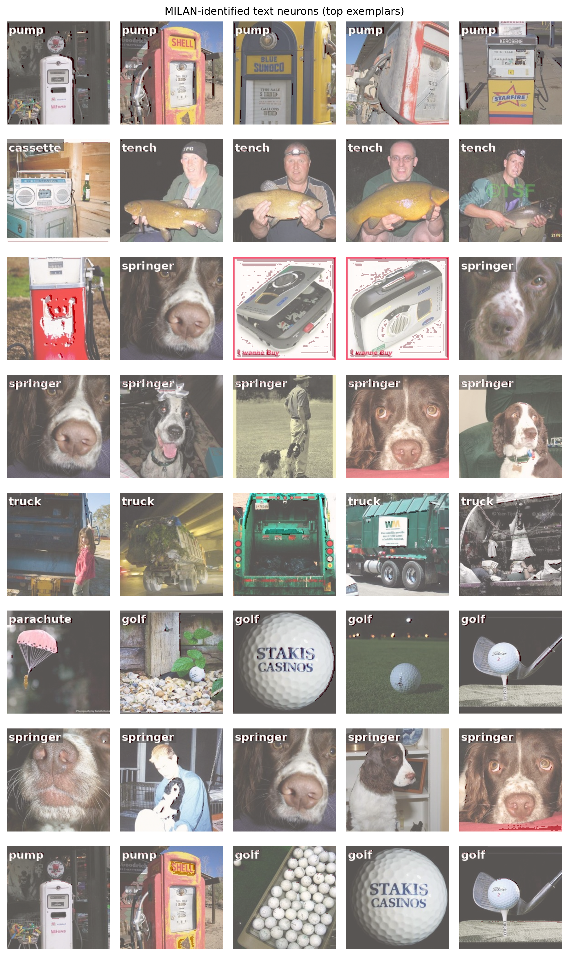
Code reproduction — text neurons (our Fig 7)
Eight MILAN-flagged text neurons from our ResNet18, with the captions as row labels.
The painted class words visible in the exemplar thumbnails ('pump', 'truck', 'springer'…) are exactly what these neurons fire on — MILAN is finding the right thing.
Notes:
Our reproduction of Fig 7. Captions like 'words'/'letters'; the overlaid words are what the neurons respond to.

Slide 21
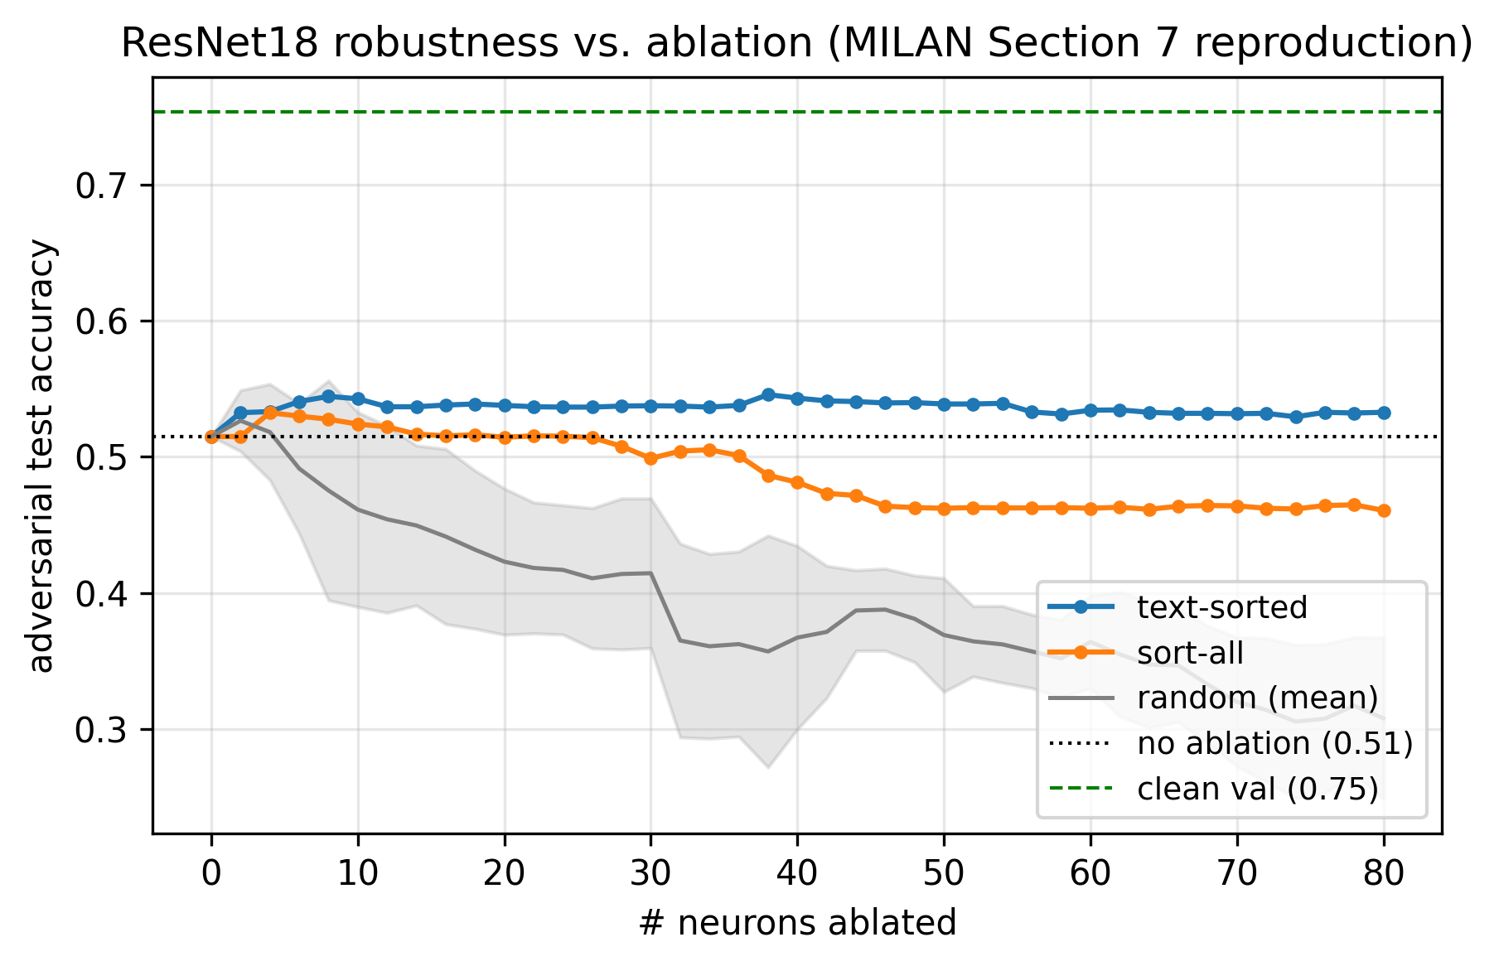
Code reproduction — ablation curve (our Fig 8)
From the 51.5% no-ablation baseline, zeroing MILAN's text neurons (blue) recovers adversarial accuracy to ~55% and holds.
Ablating the same count by importance (orange) or at random (gray) instead degrades to ~46% / ~37%.
So caption-guided editing clearly beats both baselines — the paper's Section-7 claim reproduces.
Notes:
Our Fig 8 at 10% overlay. Text-sorted is the only curve that stays above the no-ablation line.

Slide 22
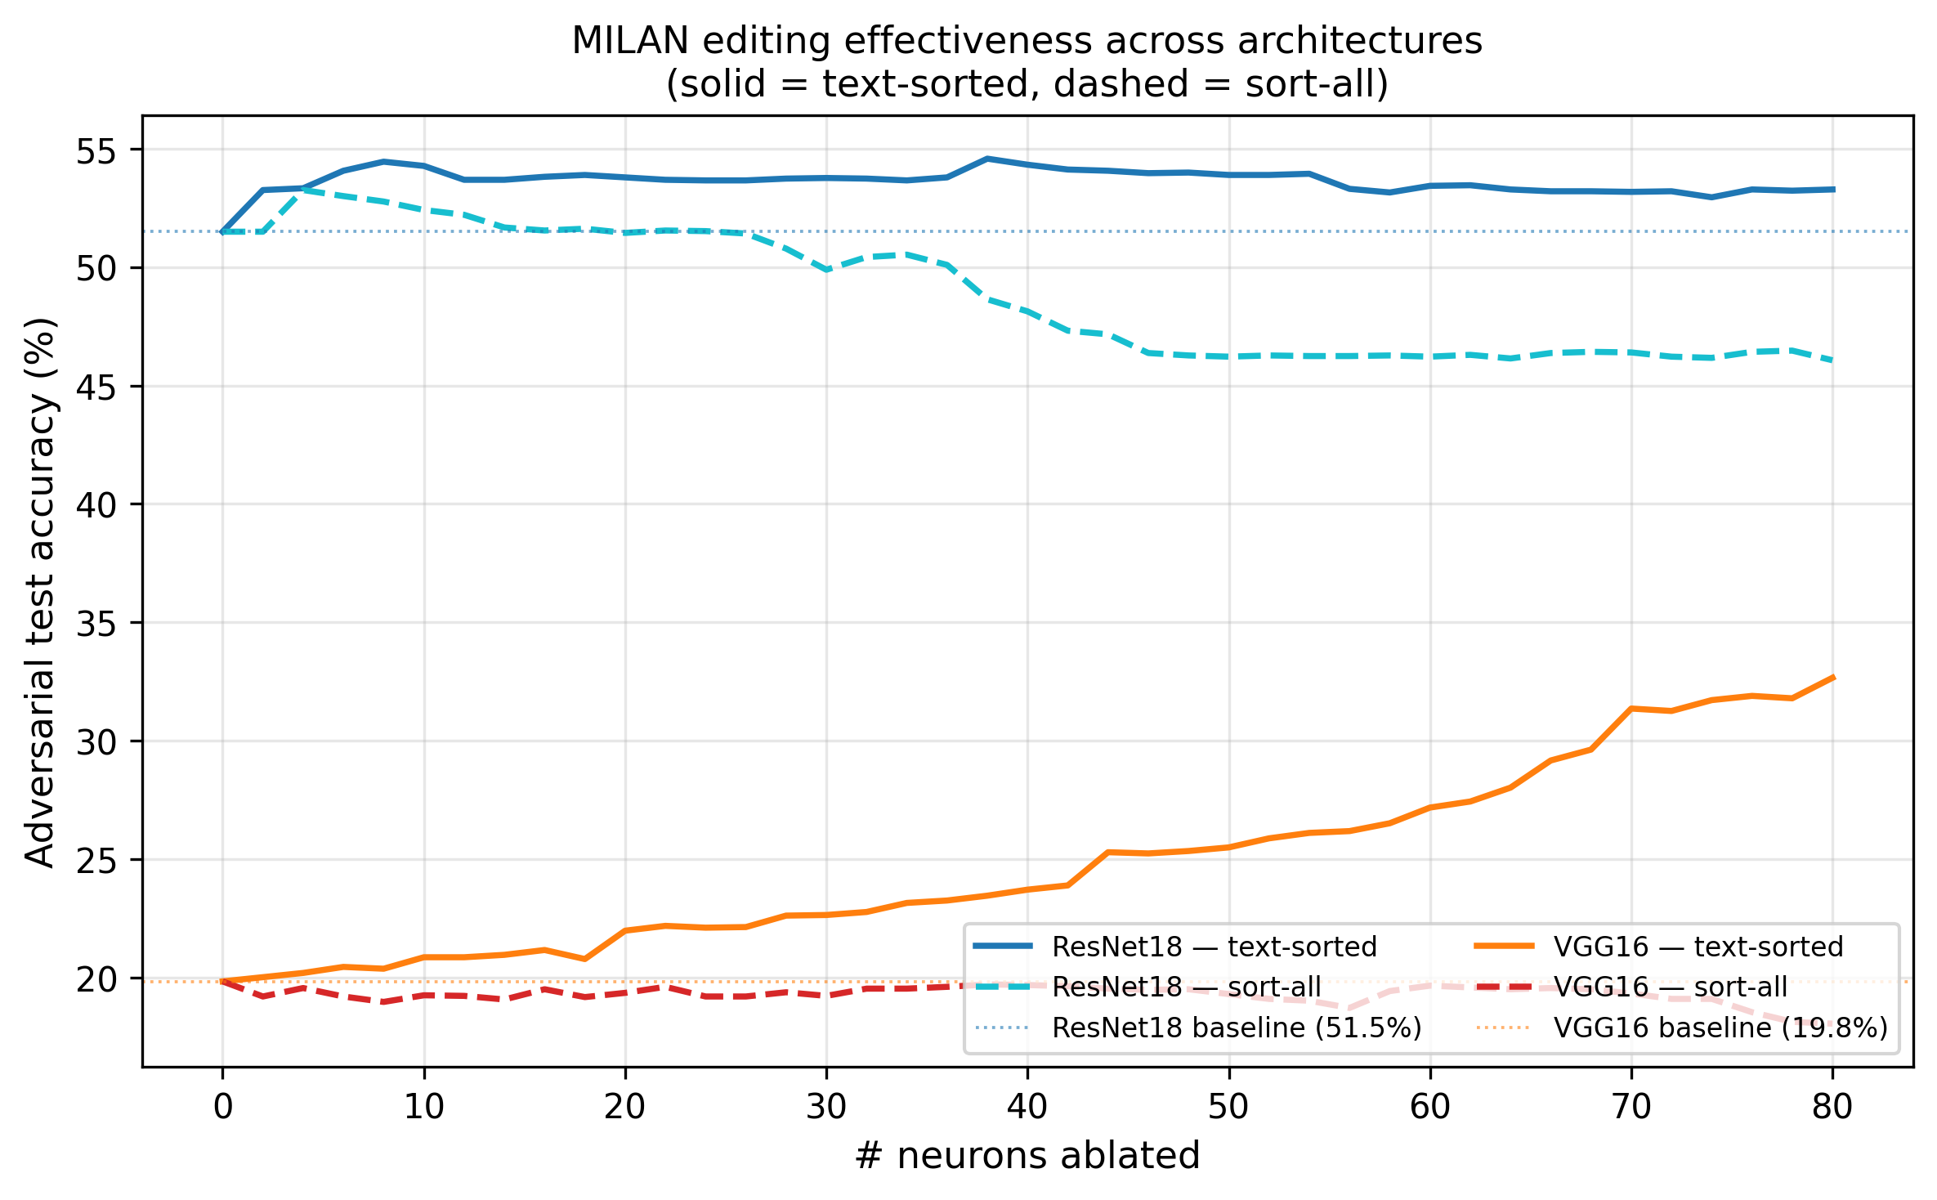
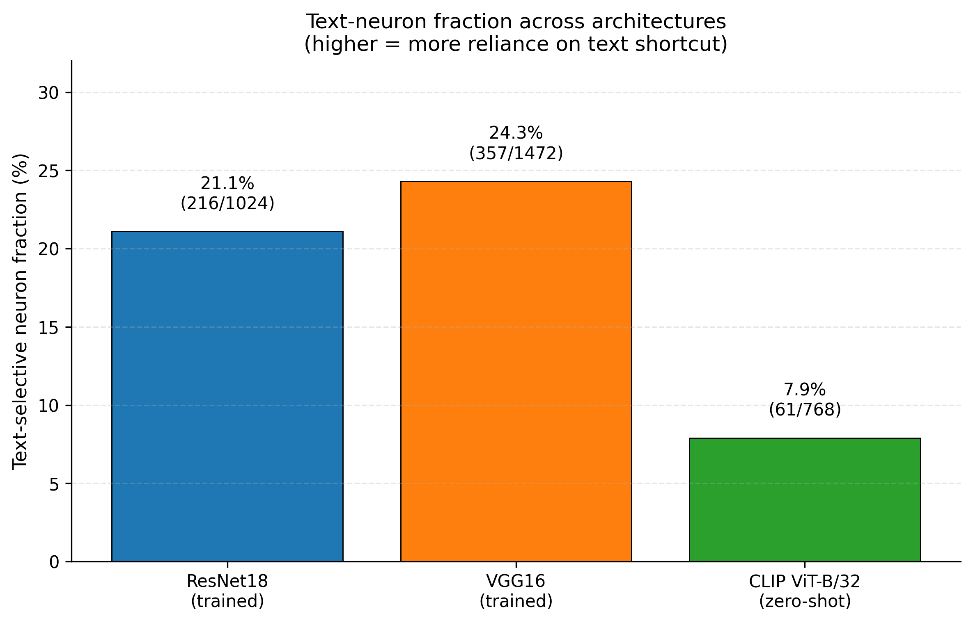
Additional experiment 1 — VGG16 generalization
VGG16 trained on the same 10% spurious set; MILAN flags 357/1472 (24.3%) text neurons.
VGG16 is more shortcut-reliant than ResNet18 (adv baseline 19.8% vs 51.5%).
Yet text-sorted ablation still recovers it strongly: 19.8% → 32.7% (+12.8pp), clearly above random — the editing generalizes across CNNs with no code changes.
Notes:
Left: per-architecture ablation curves (solid=text-sorted, dashed=sort-all). Right: text-neuron fraction across architectures. VGG16 relies on the shortcut more, but the edit still works.

Slide 23
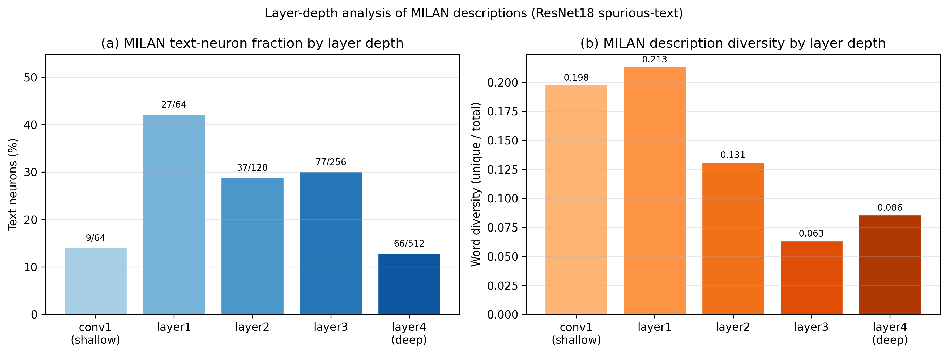
Additional experiment 2 — where the shortcut lives
Per-layer MILAN text-neuron fraction in ResNet18: 9 → 27 → 37 → 77 → 66 (conv1 → layer4).
It jumps 3.0× from conv1 (14%) to layer1 (42%) — the shortcut appears right after the first residual block — then thins out with depth.
Description diversity falls monotonically with depth: deeper neurons are more redundant / object-like.
Notes:
The shortcut crystallizes very early (layer1). Two panels: text-neuron fraction (left) and caption diversity (right) by depth.

Slide 24
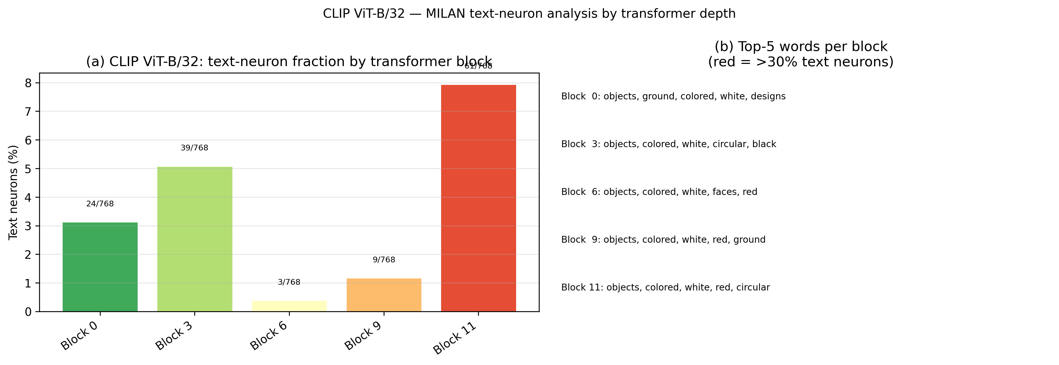
Additional experiment 3 — is CLIP more robust?
Run MILAN on CLIP's vision transformer blocks (no task training on the spurious set).
Max text-neuron fraction across blocks is 7.9% (61/768) — about 2.7× lower than ResNet18 (21.1%).
Top words are 'objects', 'colored', 'white' — not 'words'/'letters'. CLIP's vision-language pretraining is structurally more robust to text overlays.
Notes:
CLIP zero-shot: far fewer text neurons, and they describe objects not text. Quantitative evidence that vision-language pretraining resists the shortcut.

Slide 25
Sec 5: Concluding remarks

Slide 26
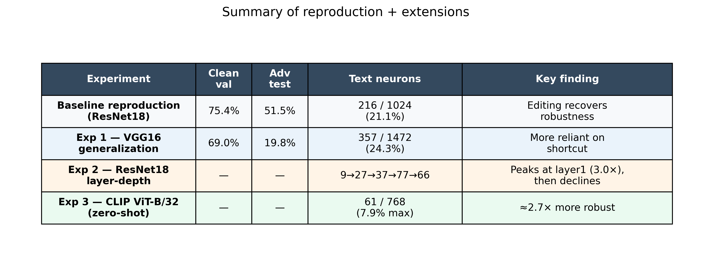
Conclusions & take-away
MILAN reproduces on Imagenette (10% overlay): 216/1024 text neurons; ablation recovers adv-acc 51.5% → ~55%, beating random/importance.
Editing generalizes across CNN architectures (ResNet18 → VGG16) with no code changes.
Spurious shortcuts crystallize right after the first residual block, then thin out with depth.
CLIP's image-language pretraining is ~2.7× sparser in text-selective neurons than a task-trained CNN.
Open-vocabulary, model-agnostic neuron descriptions are a practical handle for editing model behaviour.
Notes:
Headline takeaways at 10% overlay, with the summary table of all four experiments.

Slide 27
Sec 6: Discussion

Slide 28
What we liked / didn't like
Liked
Open-vocabulary descriptions — no concept set to engineer.
Model-agnostic — same decoder on ResNet, VGG, CLIP.
Descriptions are actionable — they enable editing, not just analysis.
Didn't like
Text-neuron identification is a brittle regex ('caption', 'sign', 'character' slip through).
Decoder is English-only, bounded by the 60k-caption corpus.
No uncertainty on captions — confidently wrong looks like confidently right.
Notes:
Honest take. Biggest like: escapes the concept-vocabulary bottleneck. Biggest dislike: the regex filter.

Slide 29
Strengths & weaknesses
Strengths
PMI objective is a clean, principled fix for generic captions.
Three case studies in the paper (BigGAN, ImageNet classifiers, adversarial editing) — real utility, not toy demos.
Pretrained decoder is plug-and-play across architectures.
Weaknesses
Decoder quality is bounded by the size/diversity of the 60k-caption corpus.
Transformer units need custom adapters — we wrote clip_glue.py to reshape ViT tokens to (B,C,H,W).
No reported test for caption consistency across seeds.
Notes:
Structural strength: PMI. Structural weakness: inherits the caption corpus's blind spots.

Slide 30
Limitations of this paper
Keyword-based text-neuron identification is brittle — 'sign', 'character', 'label' all describe text but miss the regex.
Ablation is destructive: a neuron is zeroed in full, with no graded / fine-grained edit.
Only top-k exemplars reach the decoder — rare but discriminative activations may be invisible.
Evaluation is ground-truth-free: no neuron-level gold labels, so caption correctness is largely qualitative.
Our own finding: the editing benefit depends on shortcut sparsity — at 50% overlay the shortcut pervades >half the net and caption-guided ablation no longer separates from random.
Notes:
The last bullet is our empirical contribution: editing needs an identifiable (sparse) shortcut. Addressed-in-literature: embedding-based concept detection is an active area.

Slide 31
Potential future work
Embedding-based text-neuron detection: replace the regex with sentence-encoder similarity to catch synonyms/paraphrases.
Graded edits: activation steering or low-rank shrinkage instead of zero-ablation — preserve capacity while removing the shortcut.
Beyond top-k: condition the decoder on a fuller activation distribution to surface rare features.
MILAN-for-transformers: extend to ViTs and LLM hidden states with shared adapters (start from our clip_glue.py).
Harder spurious benchmarks: Waterbirds, CelebA, NICO — multi-axis spurious correlations beyond text overlay.
Notes:
Embedding filter is the lowest-hanging fruit; activation-steering connects to recent mech-interp work.

Slide 32
References
[1] Hernandez, Schwettmann, Bau, Bagashvili, Oliva, Andreas. Natural Language Descriptions of Deep Visual Features. ICLR 2022. arXiv:2201.11114.
[2] Bau, Zhou, Khosla, Oliva, Torralba. Network Dissection. CVPR 2017.
[3] Kim et al. TCAV: Interpretability Beyond Feature Attribution. ICML 2018.
[4] Oikarinen & Weng. CLIP-Dissect. ICLR 2023.
[5] Radford et al. Learning Transferable Visual Models from Natural Language Supervision (CLIP). ICML 2021.
[6] Howard. Imagenette — github.com/fastai/imagenette.
[7] Our repo: github.com/1minute99/DSC291_Research_Reproduction.

